Slide 1
Veteran-friendly Practice Accreditation

Slide 2
Who is a veteran?
Veterans include anyone who has served for at least one day in the Armed Forces (Regular or Reserve)
By far the majority serve over 10 years

Slide 3
How many veterans are there in UK?
UK Veterans = 2.4 million
18,000 Service people leave military annually
2,500 leave the Services on medical grounds per annum
750,000 UK Armed Forces veterans of working age in England and Wales
5.4 million adult spouses, partners, widowers and child dependants
Each NHS GP will have around 30 + veterans on their list

Slide 4
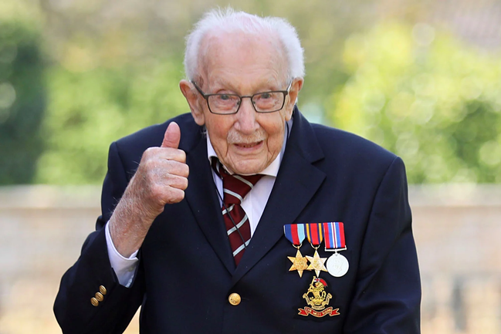
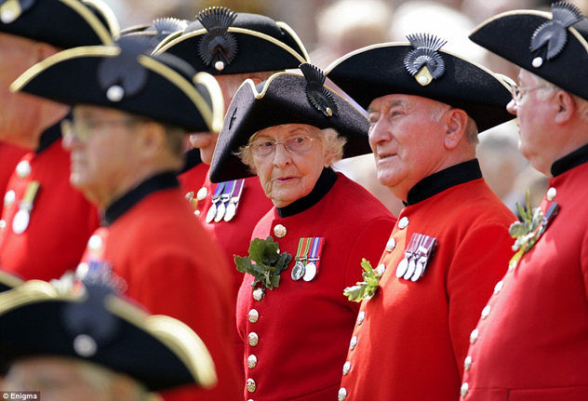
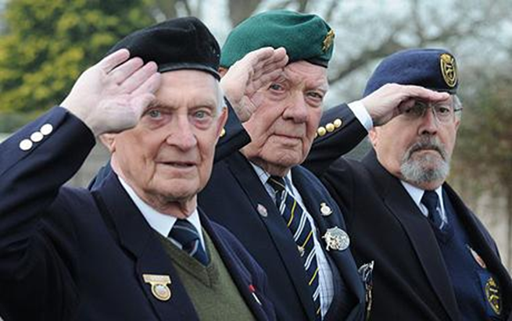

Slide 6
Armed Forces Covenant
Understanding of the veteran community & potential health problems
Awareness of and how to sign-post or refer to appropriate veteran-specific services
Request priority treatment for health problems partially or wholly attributable to military service

Slide 7
Why are veterans treated as a special group?
Service in the Armed Forces is different from other occupations
Relinquish civil liberties and put themselves in harm’s way to protect others
Risk of serious injury is substantially increased
52% of veterans have a long-term illness/disability which is higher than in the general adult population (35%)
“Leaving the military introduces a rupture across all levels”
TRIAD study, King’s College London, January 2021

Slide 8
Veterans Mental Health
UK veterans who served at time of recent military operations were more likely than non-veterans to report higher prevalence of:
Common mental health disorders 23 v’s 16%
PTSD 8%, rising to 17% of those deployed to combat roles in Iraq & Afghanistan v’s 5%
Alcohol misuse 10% v’s 5%
Delayed presentation – average of 4 years for veterans to come forward about mental health

Slide 9
Op COURAGE
The Veterans Mental Health & Wellbeing Service
https://www.nhs.uk/nhs-services/armed-forces-and-veterans-healthcare/veterans-nhs-mental-health-services/
Veteran’s Transition, Intervention & Liaison Service (TILS)
Veteran’s Complex Treatment Service (CTS)
High Intensity Service (HIS) – crisis in need of urgent care

Slide 10
Veteran’s Trauma Network
Serious injuries and long-term physical, mental or neurological health condition and disability
VTN works with DMS, national centres of clinical expertise, NHS Veterans mental health, key charities
Personalised care approach
Referral by email from GP england.veteranstraumanetwork@nhs.net

Slide 11
Veteran’s Gateway
Veteran’s Gateway – 24/7 phoneline https://www.veteransgateway.org.uk
First point of contact for welfare needs including housing, finances, employment, physical and mental wellbeing

Slide 12
Veterans eligible for priority NHS treatment
For conditions partially or wholly attributable to military service
High proportion of MSK and hearing problems amongst veterans
Highlight veteran status in referral letters, for example:
“As this patient is a military veteran and his (or her) current condition may be related to military service, this referral should be considered for priority treatment under the rules set out in the Commissioning Board Mandate, NHS constitution and Armed Forces Covenant”

Slide 14
Veteran-friendly Accreditation
RCGP are working with NHS England to accredit GP practices as 'veteran friendly’
Enables practices to deliver the best possible care and treatment for patients who have served in the Armed Forces

Slide 15
Veteran-friendly accreditation
Simple voluntary online process
Practices provide evidence that they are supportive of veterans’ healthcare
Accredited Practices are required to:
Nominate clinical lead
New patients – ask if ever served in the military
Use correct code “Military Veteran”
Attend training
Maintain CQC “positive accreditation”

Slide 16
Veteran-friendly accreditation
Once accredited practices provided with an information pack
Top Tips for GPs
Details of referral pathways
Quarterly newsletters & updates
Training opportunities & learning events

Slide 17
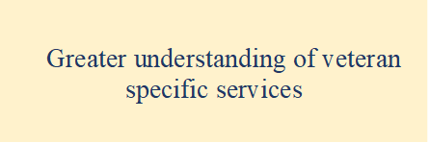
Programme Evaluation - July 2021

Slide 18
The journey so far….
More than 1500 GP Practices in England are accredited as Veteran-friendly within more practices signing-up every week

Slide 19
rcgp.org.uk/veterans

